Slide 1
Report on Civic Issues Registered by Citizens and Deliberations done by Municipal Councillors in Mumbai April 2018

Slide 2
Overall status of Complaints from 2016 to 2017
Complaint Type | Total complaints received |  | Average days to resolve a complaint
 | 2016 | 2017 | 2016 | 2017
Roads | 13,475 | 11,606 | 21 | 49
Buildings | 16,257 | 19,267 | 29 | 86
Drainage | 12,269 | 15,940 | 14 | 43
Water Supply | 7,246 | 6,959 | 19 | 39
Solid Waste Management (SWM) | 7,330 | 10,144 | 16 | 17
License | 8,368 | 10,372 | 17 | 46
Pest control | 6,078 | 5,529 | 14 | 38
Garden | 1,658 | 1,844 | 24 | 52
Colony Officer | 1,954 | 1,245 | 24 | 73
Storm Water Drainage | 1,386 | 1,532 | 23 | 58
Shop and Establishment | 561 | 1,478 | 19 | 40
Medical Officer Health (MOH) | 1,111 | 1,595 | 22 | 40
MCGM Related | 862 | 889 | 25 | 66
Estate | 560 | 407 | 25 | 80
Toilet | 290 | 416 | 21 | 33
Pollution | 220 | 215 | 26 | 83
School | 74 | 42 | 44 | 94
Nuisance due to vagrants on municipal roads, footpaths, gardens | 1,856 | 2,849 | 28 | 57
Grand Total | 81,555 | 92,329 | 19 | 48

Slide 3
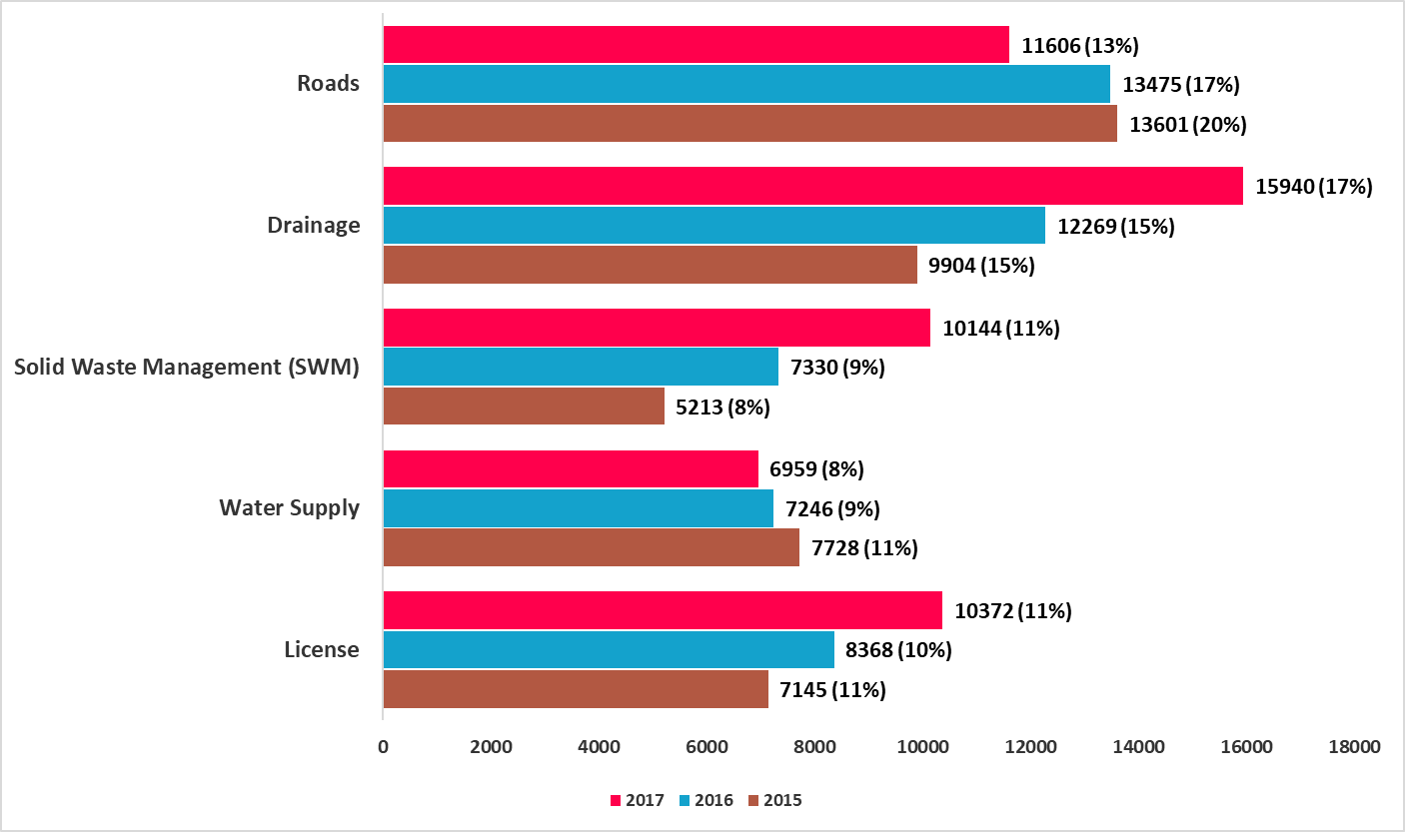
Comparison of most frequent complaints by citizens Jan 2015 to Dec 2017

Slide 4
Best & Worst Wards in Mumbai in 2017
Ward | Area | Average Days Taken to close complaint | Percentage of closed complaints
A | Colaba | 86
B | Sandhurst Road |  | 54.5%
D | Grant Road |  | 99.4%
E | Byculla | 20 | 99.8%
F/N | Matunga | 16
H/W | Bandra |  | 99.2%
L | Kurla | 13 | 15.7%
R/C | Borivali | 89
R/N | Dahisar |  | 59.2%
S | Bhandup | 93
Best Wards
Worst Wards

Slide 5
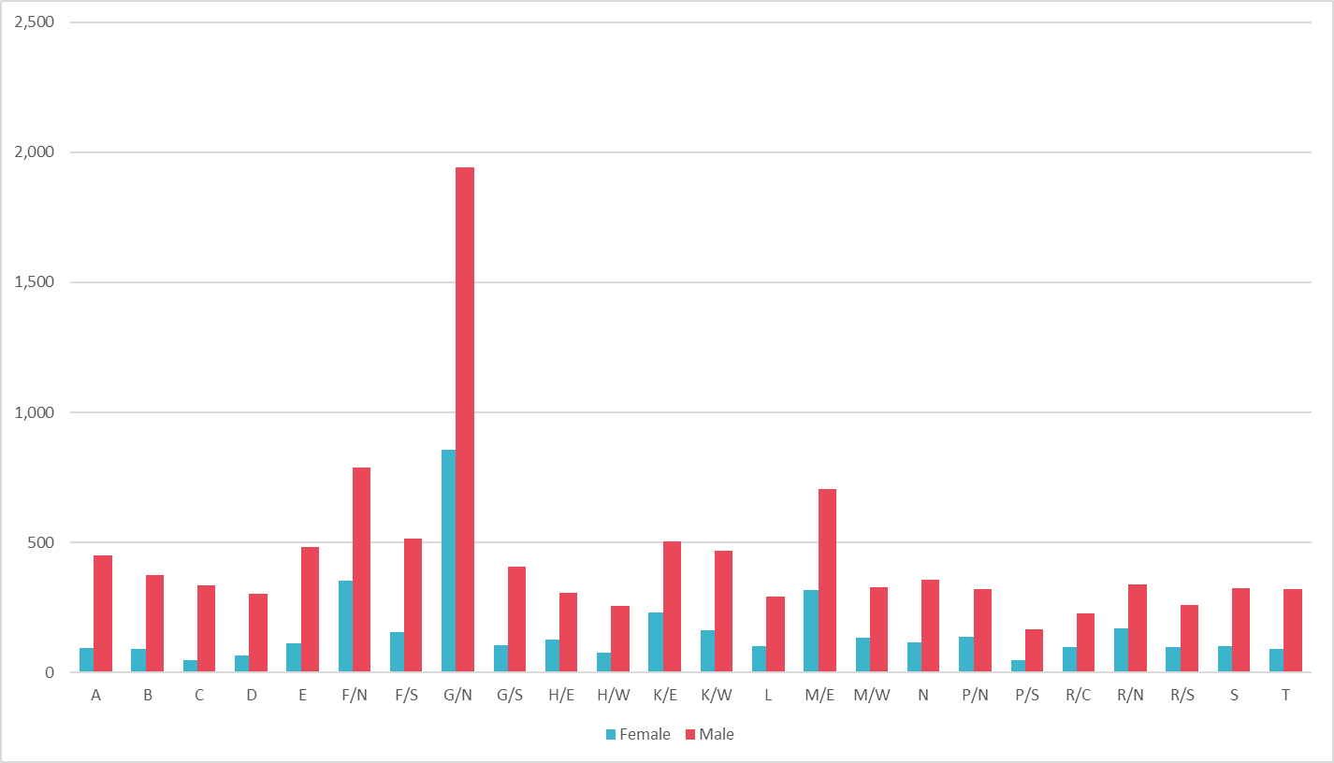
64% Disparity between Male and Female in Public Toilets as of 31st December 2017
In Mumbai, for every 3 toilet seats, 2 are for men and only 1 is for women.
C ward has the largest disparity with 85%, while R/N has the lowest disparity of 50%.
3 wards (E, R/S and N) do not have sanitation facilities for differently abled people.
Definition of an Open Defecation Free city: A city / ward can be notified/declared as ODF city/ ODF ward if, at any point of the day, not a single person is found defecating in the open.

Slide 6
Air Quality in Mumbai from 2015-2017
Air Quality Level | AQI Range | Remark | No. of Days
 |  |  | 2015 | 2016 | 2017
Good | 0-50 | Minimal Impact | 6 | 65 | 45
Satisfactory | 51-100 | May cause minor breathing discomfort in sensitive people | 157 | 177 | 134
Moderate | 101-200 | May make breathing difficult for people with lung diseases and cause discomfort in children, older adults and heart patients | 89 | 107 | 144
Poor | 201-300 | May make breathing difficult after prolonged exposure, and cause discomfort to people with heart diseases | 4 | 17 | 23
Very Poor | 301-400 | May cause respiratory illnesses in people on prolonged exposure. Effect may be more pronounced in those with lung and heart diseases. | 0 | 0 | 0
Severe | >400 | May cause respiratory problems even in healthy people, and seriously impact those with lung/heart diseases. Even increased breathing during light physical activity can impact health. | 0 | 0 | 1
Total |  |  | 256* | 366^ | 347#
* - Air Quality data was available from 20-04-2015
^ - 2016 was a leap year
# - 18 days had an ‘NA’ against their Air Qualities from the data we obtained in 2017

Slide 7
Number of meetings, attendance and questions asked in Ward Committees in 2012 & 2017
Ward Committee
Year | Total Meetings | Attend in (%) | Total Question
Mar'12 to Dec'12 | 209 | 82% | 679
Mar'17 to Dec'17 | 240 | 82% | 856
The attendance in Ward Committees of the newly elected councillors is 82%.
Interestingly, attendance from March 2012 to December 2012, when the last batch of councillors were first elected, was also 82%. However, the number of meetings was 209 in 2012, as opposed to 240 in 2017.
Number of questions asked in ward committees in 2012 was 679. Number of questions asked by new councillors of 2017 in their first year is 856.

Slide 8
Number of questions asked by Councillors in Ward Committees in 2012 & 2017
Category | No. of Members
 | Mar'12 to Dec'12 | Mar'17 to Dec'17
Zero Question | 45 | 38
1 to 5 Question asked | 150 | 134
6 to 10 Question asked | 29 | 46
Above 10 Question asked | 3 | 10
Total Members | 227 | 228*
* - Shailaja Girkar was elected in March 2017 but passed away in September 2017, and Pratibha Girkar was elected in her place. Shailaja Girkar’s questions till August 2017 have been considered. Hence, the number of councillors has been shown as 228 and not 227.
Maximum number of councillors asked between 1 to 5 questions in 2017 (134 Councillors).
38 councillors have not asked a single question between March 2017 (from the start of the elections) to December 2017. This is lower than the 2012 figure of 45.

Slide 9
Issue-wise number of questions asked in Ward Committees in 2012 & 2017
Issues | Question asked
 | Mar ‘12 to Dec ‘12 | Mar ‘17 to Dec ‘17
Drainage | 30 | 42
Solid Waste Management (SWM) | 62 | 76
Water Supply | 47 | 56
License | 29 | 47
Roads | 102 | 151
Storm Water Drainage | 31 | 39
Toilet | 19 | 42
Pest control | 11 | 7
Garden/Open space | 28 | 38
Community Development | 13 | 32
Health | 19 | 19
Education | 19 | 10
Naming/Renaming of Roads/ Chowks | 127 | 125
Other issues related | 142 | 172
Total | 679 | 856

Slide 10
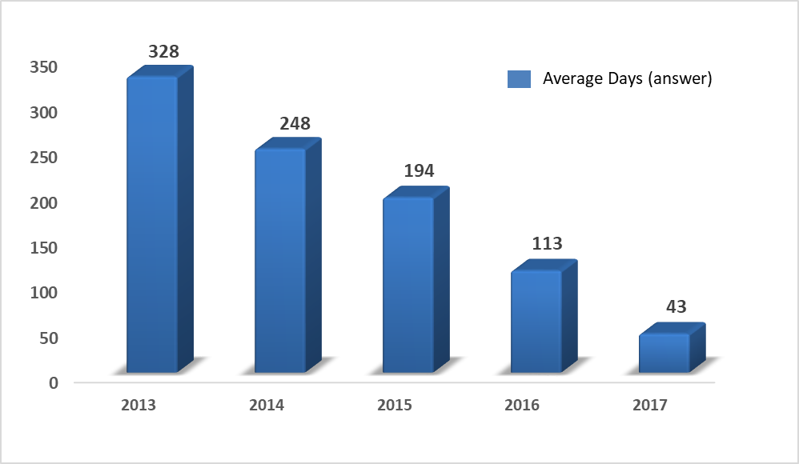
Comparison of the average days taken to answer Point of Order questions in the Ward Committees from 2013 to 2017
To the administration’s credit, the average number of days to answer Point of Order questions has steadily decreased from 328 days in 2013 to 43 days in 2017.
Notes:
The top concern of councillors over the past 5 years has been “

Slide 11
Analysis of Political Party Manifestos
The most objective way of analysing this is by comparing the promises in the manifestos with the questions asked by the councillors in the corporation and its various committees. For this, we collated all the promises made by major political parties in their manifestos and divided them into several broad categories. Not all parties have necessarily asked questions related to all of these categories. Within these categories, we have compared specific issues raised by the parties in their manifestos with questions raised by them in the preceding years. Thus, we have restricted our analysis to these sub-issues rather than focusing on broader issues.
In our analysis we have compared Issues in Political Party Manifestos for 2017 MCGM elections and Questions asked by respective Party Councillors during March 2017 to December 2017. We have given the benefit of doubt to political parties while comparing issues mentioned in the manifestos with questions raised earlier. For example, if completion of the Gargai project was listed as an issue in the manifesto, questions related to increased water supply were taken as being related to this issue, even if the questions were not specifically about the project. This is because although the completion of the project is a specific issue, it is linked to the broader question of adequate water supply.

Slide 12
Party-wise analysis of Manifestos
Political Party | No. of sub-points in Manifesto* | Number of Questions asked (Mar '12 - Dec '16) | Number of Questions asked (Mar '17 - Dec '17)
BJP | 240 | 579 | 272
SS | 39 | 1380 | 104
INC | 62 | 786 | 34
NCP | 71 | 345 | 23
* ‘Sub-points’ indicate number of promises made in the manifesto of the concerned party

Slide 13
What needs to be done
Creating an Open Dashboard on the Municipal Corporation of Greater Mumbai (MCGM) website to monitor and evaluate civic complaints, they believe, will allow elected representatives and administration officials in overseeing the corporation’s performance on a real-time basis. This move will also be an encouraging step towards Open Government Data.
Additionally, the MCGM must strictly adhere to rigorous filling of the ‘Councillor Code’. Making filling of the councillor code mandatory will go a long way in addressing the lack of accountability in the working of the civic body.
Finally, a Citizen Feedback mechanism for gauging citizens’ satisfaction with the solution to their problems must be created.
Just like the ‘power of the purse’ at the national level is with the Lok Sabha, the elected House, the preparation and presentation of the budget should be a responsibility of the elected (deliberative) body of the MCGM.

